Slide 1
TAS152
LECTURE 16
TOPIC 2
ETHICS IN THE INFORMATION SOCIETY
2.9 POLICY: THE ETHICS OF REGULATION AND FREEDOM

Slide 2
REGULATORY FRAMEWORKS IN A KNOWLEDGE SOCIETY
Stifling technological innovation will not solve the problem of needing regulation.
Tech enables freedom of expression/association, and the right to receive/send information.
What is free speech?
Freedom to articulate your opinion/idea without fear of retaliation, censorship, or legal sanction. The right to freedom of expression is a human right.
What are our rights in South Africa? The right to freedom of expression is in section 16 of the Constitution.
The Constitution protects the rights to expression but expression which is hurtful, harmful or incites harm, and promotes or propagates hatred is unlawful and is not protected.

Slide 3

THE DARKWEB
Excessive regulation often leads to users simply finding different ways to interact online i.e. using the darkweb.
What is the darkweb?
Normally we use the surface web.
There is a difference between the darkweb and the deepweb.
The darkweb exists on an entirely different physical network to the internet
Advanced encryption and routing schemes apply
You need a specialized browser (Tor)
https://www.aura.com/learn/dark-web

Slide 4
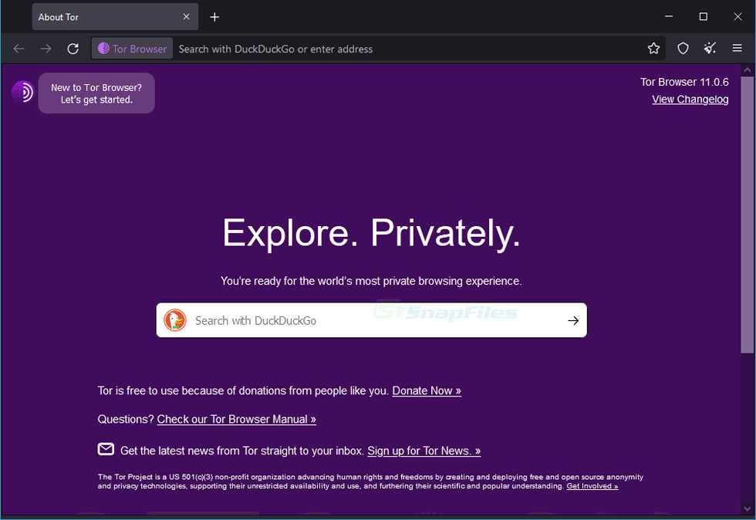
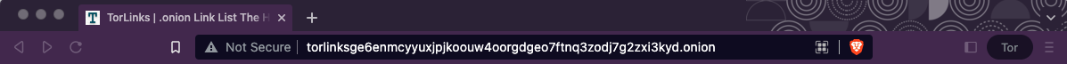
TOR BROWSER AND .ONION LINKS

Slide 5
IS THE DARKWEB BAD?
Like any technology, the darkweb is neutral the ethics depends on its use.
Ethical uses of the darkweb:
Increased anonymity
Access to information that is restricted on the clearweb
Unethical uses of the darkweb:
Drug and weapons trade
Child exploitation materials
Selling and buying of personal info like credit card details and identity documents.

Slide 6
HOW WILL WE EVER MANAGE TO REGULATE THE INTERNET?
There's a long road ahead, but we need to stick to the basics:
Transparent, informed and democratic debate to ensure that access to information and knowledge is protected at national and international levels.
This is not a black and white issue, the solution is somewhere in the grey.
A completely unregulated Internet risks perpetuating unequal levels of information access.
A more regulated Internet may prioritise economic/commercial goals above equity of access.
Closure of physical resources such as libraries exacerbates the problem.
Work from the existing policy frameworks

